Slide 1
Web scraping with python
10/2019
Applied Analytics Club

Slide 2
Set Up
Google Chrome is recommended to follow along with this tutorial
Python 3.6 or higher is required
If you haven’t done already, download and install Anaconda Python 3.7 Version at:
https://www.anaconda.com/distribution
Next, use Terminal or Command Prompt to enter the following, one by one:
pip install bs4
pip install selenium
pip install requests
In case of errors, raise your hand and we will come around. For those who have successfully completed the install, please assist others.

Slide 3
Set Up
Google Chrome is recommended to follow along with this tutorial
Python 3.6 or higher is required
If you haven’t done already, download and install Anaconda Python 3.7 Version at:
https://www.anaconda.com/distribution
Next, use Terminal or Command Prompt to enter the following, one by one:
pip install bs4
pip install selenium
pip install requests
In case of errors, raise your hand and we will come around. For those who have successfully completed the install, please assist others.

Slide 4
Contents
Define Scraping
Python Basic Components (Data Types, Functions, Containers, For Loops)
Applications:
Beautiful Soup
Demonstration with Follow Up
Practice Exercise
Selenium
Demonstration with Follow Up
Practice Exercise
Things to keep in mind when scraping (robots.txt)
Challenge Introduction
Q & A

Slide 5
Web Scraping
Used for extracting data from websites
Automates the process of gathering data which is typically only accessible via a web browser
Each website is naturally different, therefore each requires a slightly modified approach while scraping
Not everything can be scrapped

Slide 6
Python Basics: Data Types
Int e.g. 2,3,4
Float e.g. 2.0,3.4, 4.3
String e.g. “scraping ftw!”, ”John Doe”
Boolean True, False
Others (Complex, Unicode etc.)

Slide 7
Python Basics: Functions
Functions start with “def” with the following format
def function1(paramter1,parameter2):
answer = parameter1+paramter2
return answer
There are two ways to call functions:
Function1()
E.g. type(5) # int
Object.function1()
“python”.upper() # “PYTHON”
Used under different circumstances (examples to come later)

Slide 8
Python Basics: Lists
Type of data container which is used to store multiple data at the same time
Mutable (Can be changed)
Comparable to R’s vector
E.g. list1 = [0,1,2,3,4]
Can contain items of varying data types
E.g. list2 = [6,’harry’, True, 1.0]
Indexing starts with 0
E.g. list2[0] = 6
A list can be nested in another list
E.g. [1 , [98,109], 6, 7]
Call the ”append” function to add an item to a list
E.g. list1.append(5)

Slide 9
Python Basics: Dictionaries
Collection of key-value pairs
Very similar to JSON objects
Mutable
E.g. dict1 = {‘r’:4,’w’:9, ‘t’:5}
Indexed with keys
E.g. dict1[‘r’]
Keys are unique
Values can be lists or other nested dictionaries
A dictionary can also be nested into a list e.g. [{3:4,5:6}, 6,7]

Slide 10
Python Basics: For Loops
Used for iterating over a sequence (a list, a tuple, a dictionary, a set, or a string)
E.g.
cities_list = [‘hong kong”, “new york”, “miami”]
for item in cities_list:
print(item)
# hong kong
# new york
# miami

Slide 11
Beautiful Soup
Switch to Jupiter Notebook
Open Anaconda
Launch Jupyter Notebook
Go to IMDB’s 250 movies:
https://www.imdb.com/search/title?genres=drama&groups=top_250&sort=user_rating,desc

Slide 12
Selenium
Download the chrome web driver from
http://chromedriver.chromium.org/downloads
Place the driver in your working directory
Continue with Jupyter Notebook

Slide 13
Scraping Ethics
Be respectful of websites’ permissions
View the website’s robots.txt file to learn which areas of the site are allowed or disallowed from scraping
You can access this file by replacing sitename.com in the following: www.[sitename.com]/robots.txt
E.g. imdb’s robots txt can be found at https://www.imdb.com/robots.txt
You can also use https://canicrawl.com/ to check if a website allows scrapping
Don’t overload website servers by sending too many requests. Use “time.sleep(xx)” function to delay requests.
This will also prevent your IP address from being banned

Slide 14
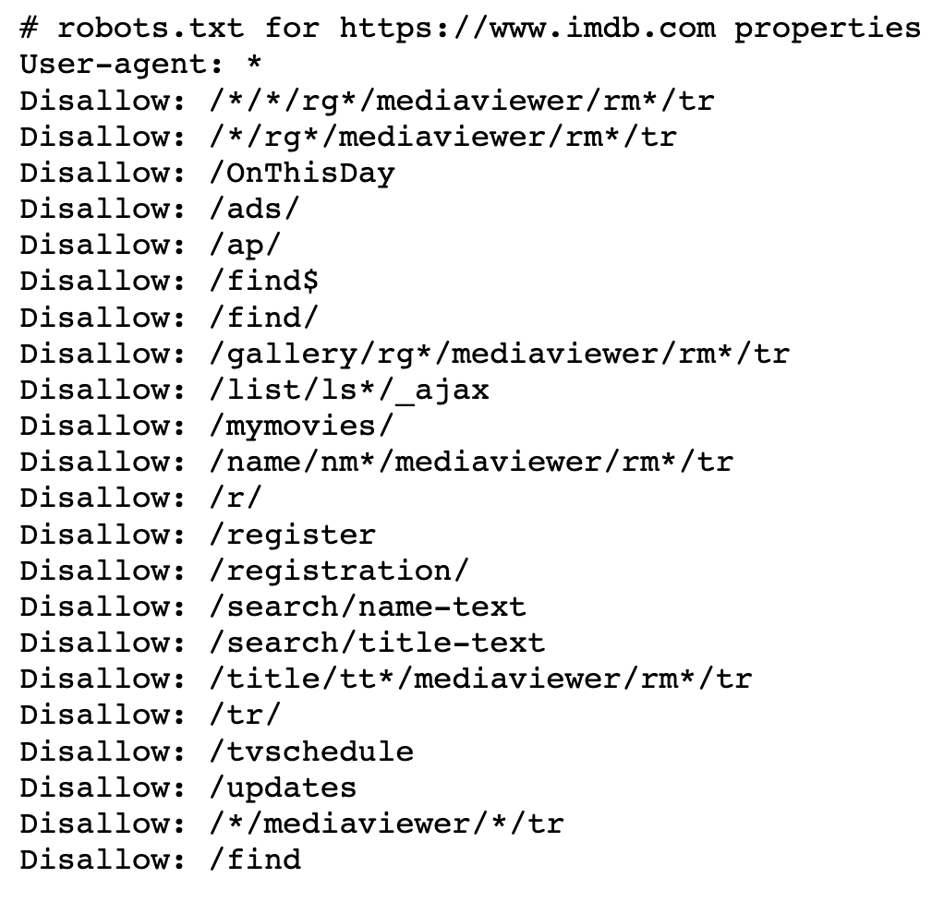
Interpreting the robots.txt file
All pages of the website can be scrapped if you see the following:
User-agent: *
Disallow:
None of the pages of the website can be scrapped if you see the following:
User-agent: *
Disallow: /
Example from imdb →
The sub-directories mentioned here are disallowed from being scrapped

Slide 15
Take-home Challenge
Scrape a fictional book store: http://books.toscrape.com/?
Use what you have learned to create efficiently scrape the following data for Travel, Poetry, Art, Humor and Academic books:
Book Title
Product Description
Price (excl. tax)
Number of Reviews
Store all of the data in a single Pandas DataFrame
The most efficient scraper will be awarded with a prize
Deadline for submissions are in a week from today, 4/18/2019 11:59pm

Slide 16
Resources
https://github.com/devkosal/scraping_tutorial
All code provided in this lecture can be found here
http://toscrape.com/
Great sample websites to perform beginner to intermediate scrapping on
https://www.edx.org/course/introduction-to-computer-science-and-programming-using-python-0
Introduction to Computer Science using Python
Highly recommended course on learning Python and CS form scratch
https://www.promptcloud.com/blog/how-to-read-and-respect-robots-file/
Further reading on interpreting robots.txt
https://canicrawl.com/
Check scraping permissions for any website

